Slide 1
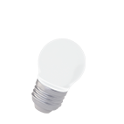
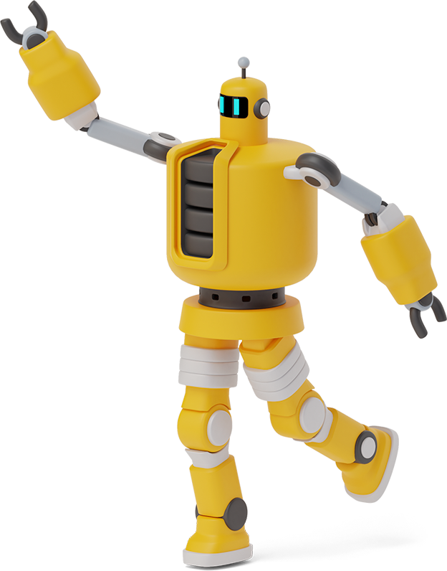
Python Playground

Slide 2
Roadmap
Homework Takeup
For Loops
Class Activity
1
3
5
2
4
6
Review of Past Class
Range() Function
Lists

Slide 3
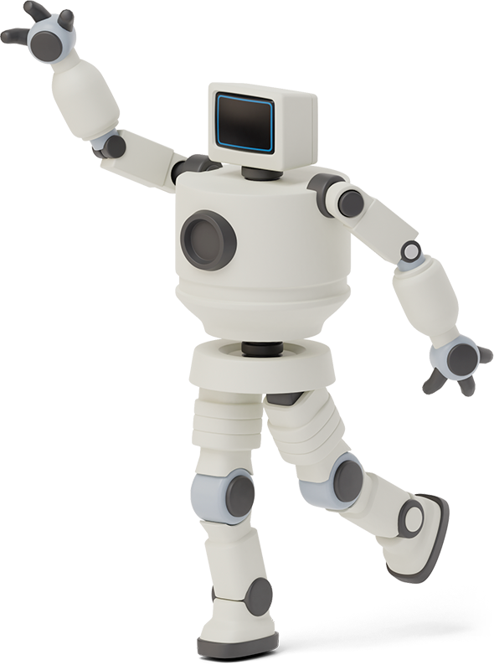

Homework Link
https://github.com/Asfandyar-Khan/PythonPlayground/blob/main/index.md
Contains all lectures and Google Colab notebooks
Contains homework which will be a word document
Does anyone have any homework questions?
New file – Python Project Ideas

Slide 4
Review of Last Week
Prior week’s homework questions
Functions with return values
For Loops
range() function
Using range() in a for loop

Slide 5
This week...
Take up Week 6 Homework
Review For Loops
Review using range() in for loops
Lists
.append()
Index[] mechanism
Tuples

Slide 6
Let’s Review For Loops

Slide 7

For Loops
A for loop iterates over a sequence – such as a string, list, or tuple
Allows you to run a block of code repeatedly
This occurs once for each item in the sequence
Syntax:
for item in iterable:
# Code to be executed for each item

Slide 8
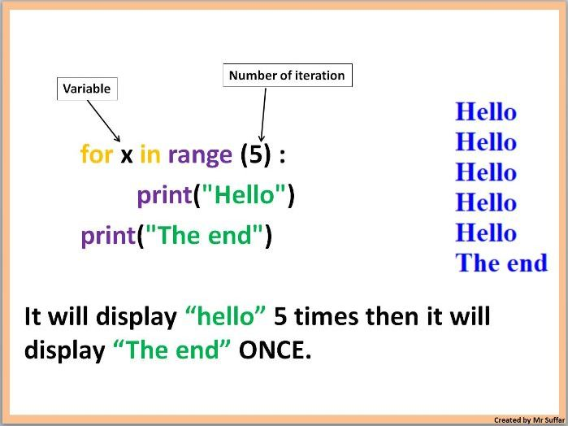
For Loops

Slide 9
For Loops – range() function
range() function
range(start,stop,step): 3 parameters
range(start): initiate the sequence of numbers with the start number
range(stop): will generate a sequence of numbers from 0 up to, but not including, stop
range(step): will jump between start and stop numbers by increment of step

Slide 10

Class Activity – For Loops
Question: Write a for loop that prints the numbers from 1 to 10 (including 10).
Hint: Use range(1, 11) — remember, Python stops before the stop number.

Slide 11
Class Activity – For Loops
Question:
Write a program that:
Uses a For Loop with range(1,6)
Adds all the numbers together
Prints the final sum
Hint: Create a variable called total = 0 at the start of your program. Use total = i + total after the for loop.

Slide 12



Lists – Data Structure
Lists
Lists are a data structure that is used to
collect data items
Can hold both integers and strings!
They are mutable (changeable)
Lists maintain a defined order
The first item is given priority
Then the second item, and so on...

Slide 13
Tuples – Data Structure
Tuples
Lists are a data structure that is used to collect data items
They are mutable (changeable)
Lists maintain a defined order
The first item is given priority
Then the second item, and so on...

Slide 14
Thanks!
Any questions?

